Slide 1

Cost of Living Project Using Power BI
By
NZURUMIKE OBIANUJU LYNDA (Ph.D.)

Slide 2

INTRODUCTION
The cost of living is a critical factor that affects individuals and businesses. It is important to analyze and visualize data on cities and countries to make informed decisions about relocation, investment, or business expansion. In this project, I utilized Power BI to preprocess, create visuals, analyze the cost of living dataset to draw meaningful conclusions to address real-world issues related to economics and living standards in various countries and cities around the world.

Slide 3
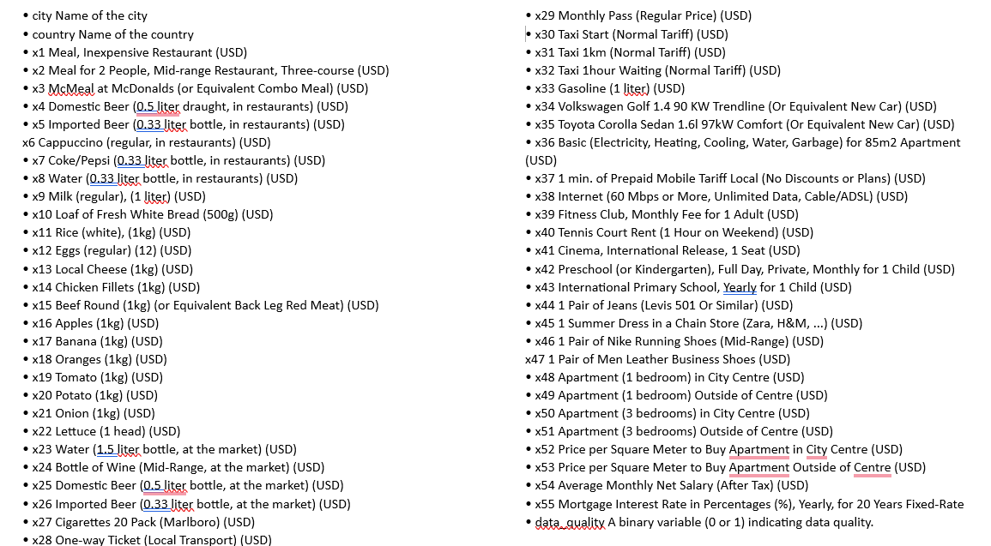
The dataset consists of the following variables:

Slide 4
This project aims to address these key questions:
• What are the cities and countries with the highest and lowest costs of living?
• What are the major cost components contributing to the overall cost of living
in a region?
• How do factors like average salary, housing costs, and transportation
expenses correlate with the cost of living?
• Are there any trends or patterns in the data that can help individuals and
organizations make strategic decisions?

Slide 5
STEPS FOLLOWED
Understanding the Dataset
2. Data cleaning and transformation in Data Query Power BI
3. Exploratory data analysis (EDA)
4. Data Analysis and Visualization
5. Interpretation of the results and Findings

Slide 6
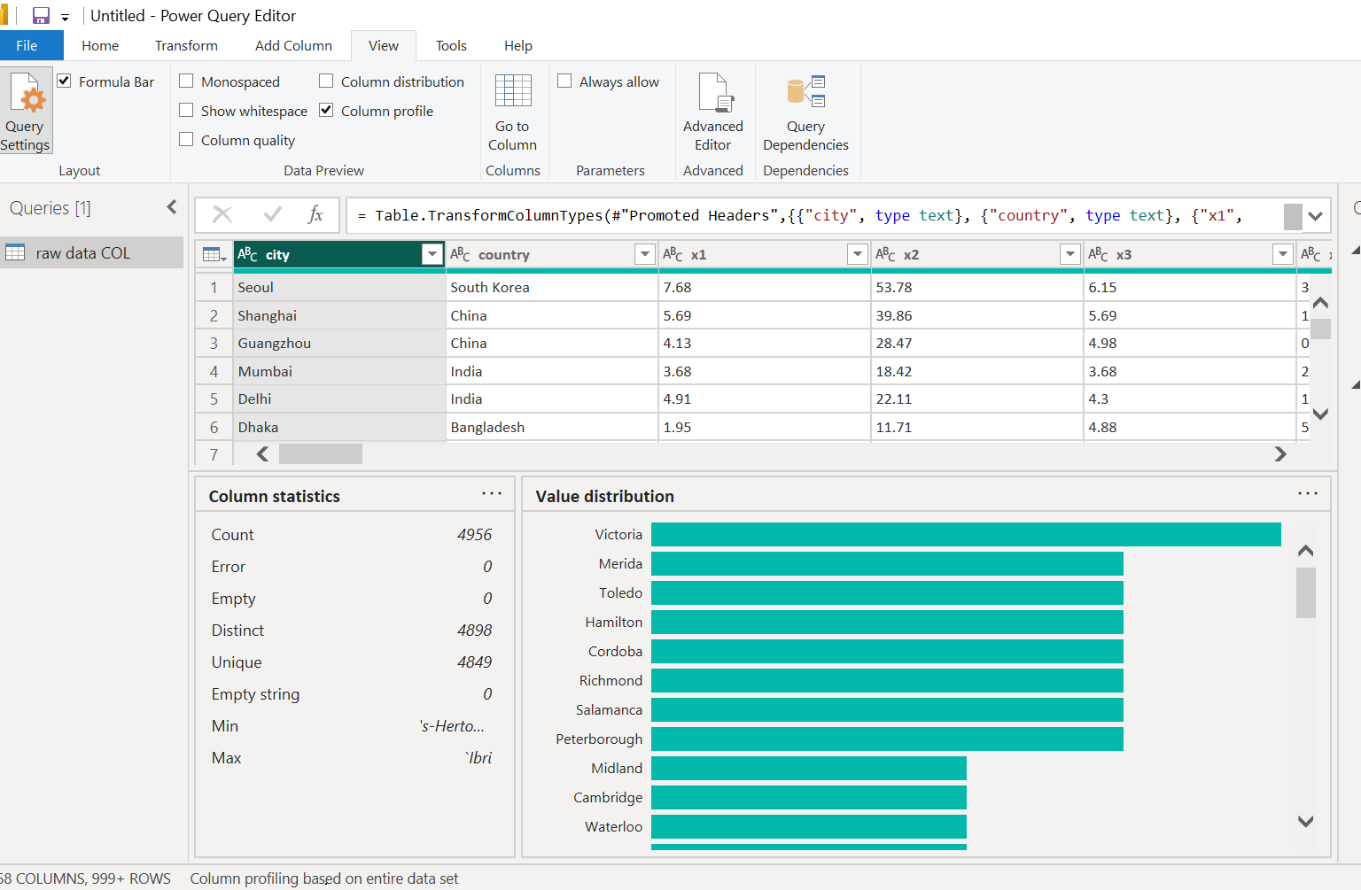
1. Understanding the Dataset
I downloaded the CSV files and started by opening them in Excel just to get an overview of the data. I observed that the column names are represented with numbers instead of their actual, descriptive names, which I re-labelled
Then uploaded the data on Power Query and used Column profile. The following were observed:
This dataset contains information about the cost of living in 4956 cities across the world with 4898 distinct values.
The Data contains 56 columns
The data type for the numerical measures (x1 to x55) were text as against float or decimal type

Slide 7
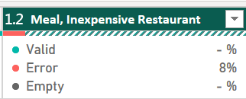
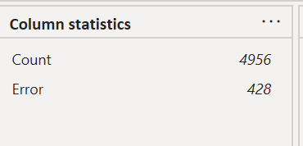
2A: Data Cleaning procedure
The column headings were relabelled in Excel to denote the dataset descriptions
The data type for the numerical measures (x1 to x55)
was changed to type floating (decimal). Chaing the
data type resulted to errors in the column as seen
The column statistics showed there were 428 rows
with errors
The errors which were either null(nan) or empty values were removed.

Slide 8
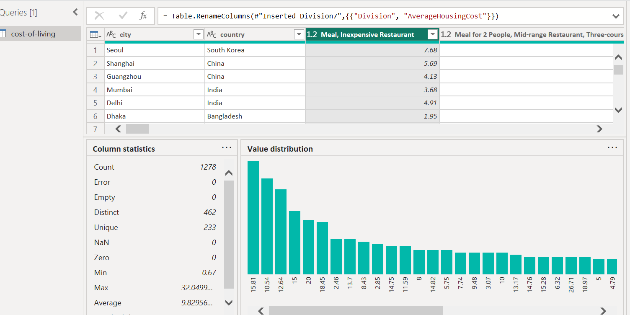
After the errors were removed, the total number of clean Datasets to work with was reduced from 4995 to 1278. Although the data lost was huge, it will ensure the correctness and reliability of the information or conclusions drawn from the analysis of the dataset

Slide 9
1B. Data Transformation Steps
In the data transformation stage, Additional columns were created to help calculate the cost of living (the amount of money needed to cover basic expenses such as housing, food, taxes, and healthcare.)
Total Cost of living – gotten from adding up the variables x1 to x53 for each row.
Average cost of living – gotten from dividing the total Cost of living by the total number of expenses columns (53)
The variables x1 to x53 were further grouped into related categories to help organize the data a little better. These includes Food, Transportation, Amenity, Children’s school, clothing and housing costs
And steps 1 and 2 above were repeated. To find their total and Average costs respectively

Slide 10
2. Exploratory Data Analysis (EDA)
At the end of the transformation I had 71 columns, which I saved and applied to get to the power BI Desktop
In the Exploratory Data Analysis (EDA), I explored several factors in the dataset and also reveal whether there are relationships between some of the factors
The EDA revealed that there is a linear relationship between the Average Cost of living and some other factors including Average Accommodation Cost, Average Children School Cost, Average Feeding Cost, Average Transportation Cost & Average Amenities Cost
In the EDA, I also got insight about top/bottom countries and cities with the highest/lowest average cost of living

Slide 11
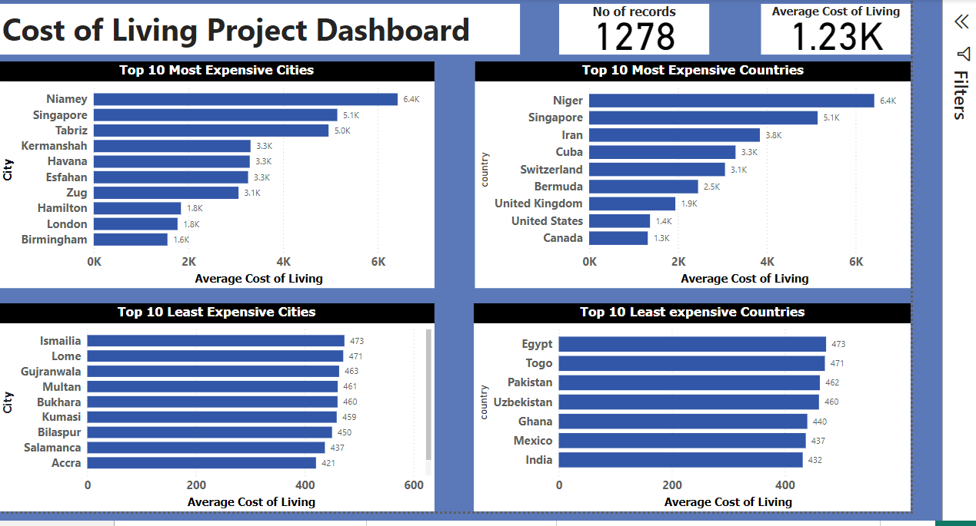
3. Data Analysis and Visualization
To Answer the Questions I used visualization and analysis
1. What are the cities and countries with the highest and lowest costs of living?

Slide 12
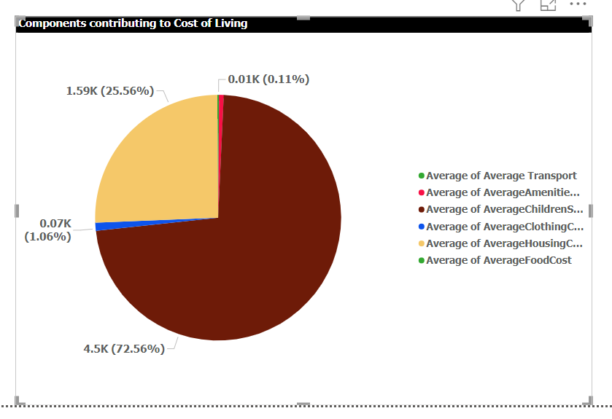
2. What are the major cost components contributing to the overall cost of living in a region?
The major components contributing the overall cost of living are Children’s School with a percentage of 72.56% and Housing cost with 25.56%.
Amenties, clothing, food and transport costs’s contributring less than 2% of the total

Slide 13
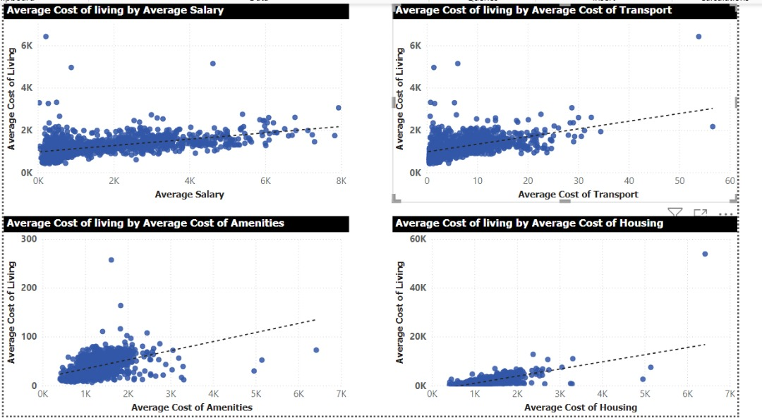
3. How do factors like average salary, housing costs, and transportation expenses correlate with the cost of living?
There is a positive linear correlation between them as seen in the line graphs below. The Higher the cost of living, the higher the expenses with some few notable outlines

Slide 14
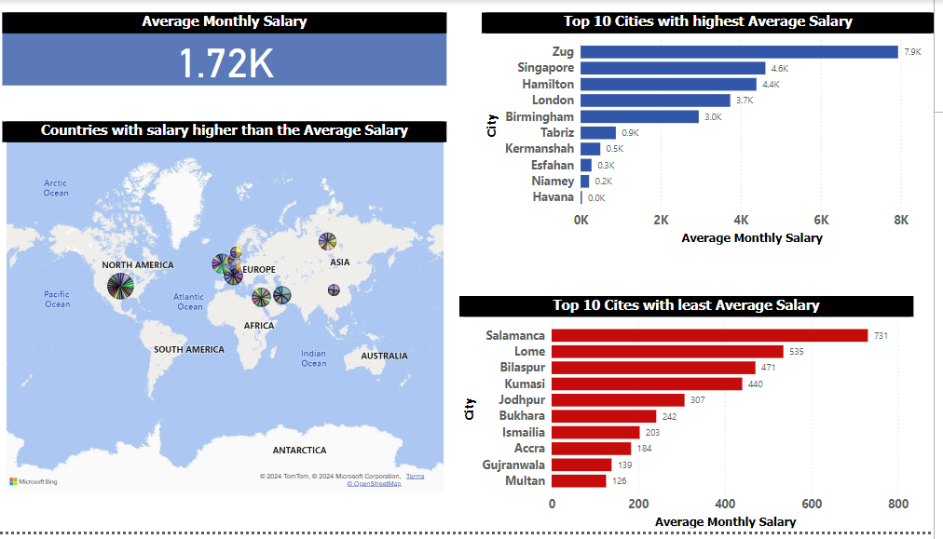
4. Are there any trends or patterns in the data that can help individuals and organizations make strategic decisions?
A. Individuals interested in relocating to high-income cities should consider cities in Blue and avoid cities in Red. Also, note that in countries shown on the map workers earn salaries above the average Salaries of all the other countries

Slide 15
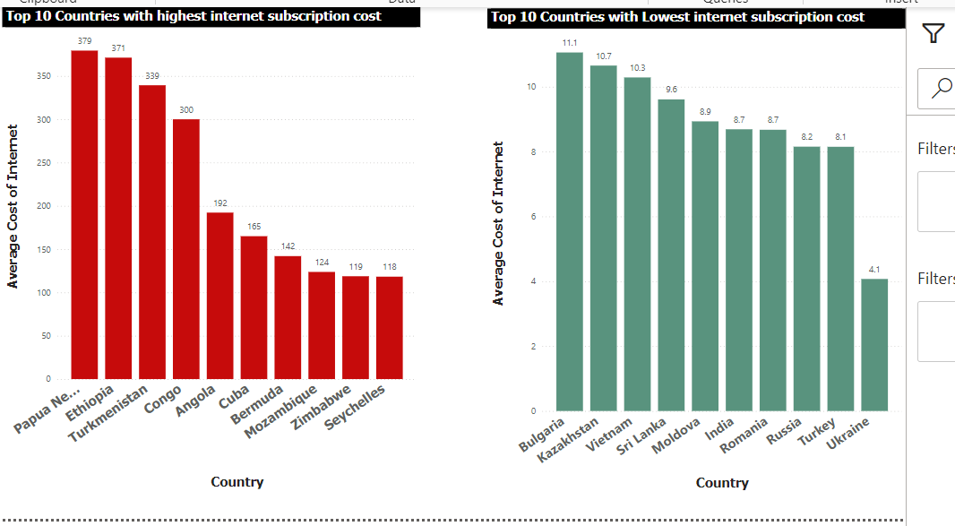
B. Consider going to the countries in green if your organization is high on internet subscription due to low cost and avoid the countries in Red

Slide 16
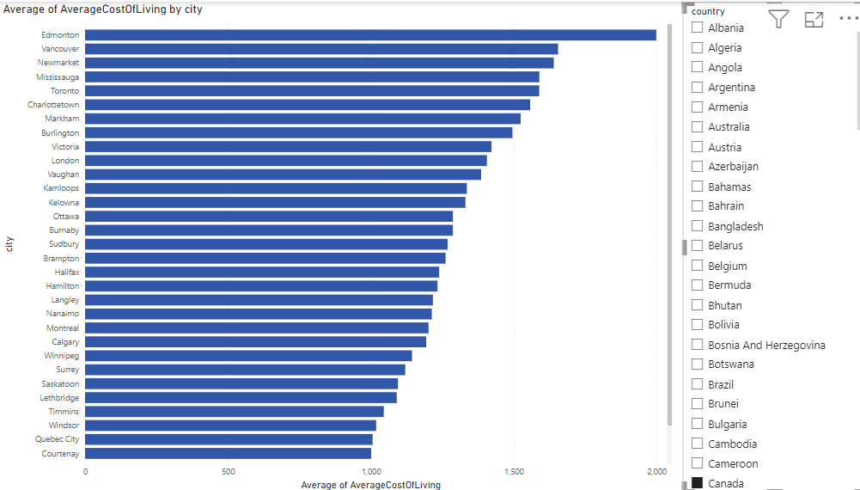
C. With this Visual, you can determine which city to visit, when in a country, the higher the average cost of living the more expensive to reside or do business in that city For Example by selecting the country from Canada in black from the slicer. It can be seen that it is most expensive to live in Edmonton and cheapest to live in Courtenay

Slide 17
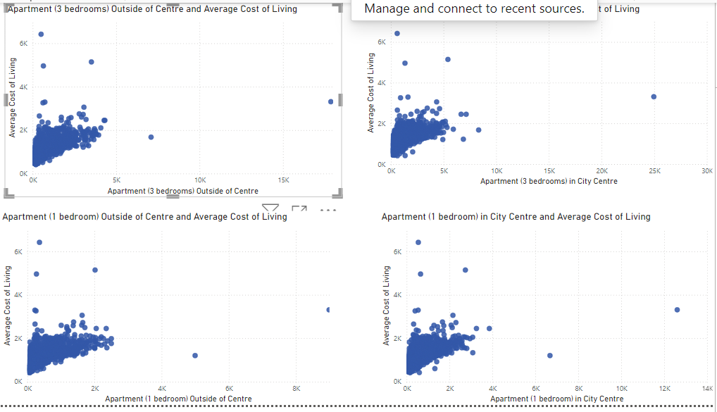
D. There is a positive correlation between the cost of living and the prices of apartments. Countries tend to spend more on housing where the cost of living is higher
.

Slide 18
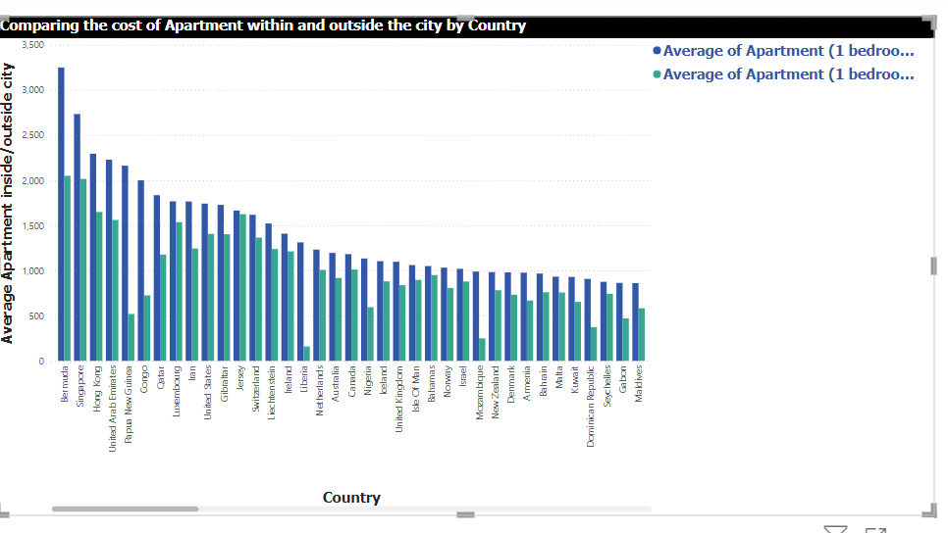
E. Across all the countries shown, it is more expensive to live outside the city. So if you are a low-income earner, considering renting an apartment outside the city
.

Slide 19
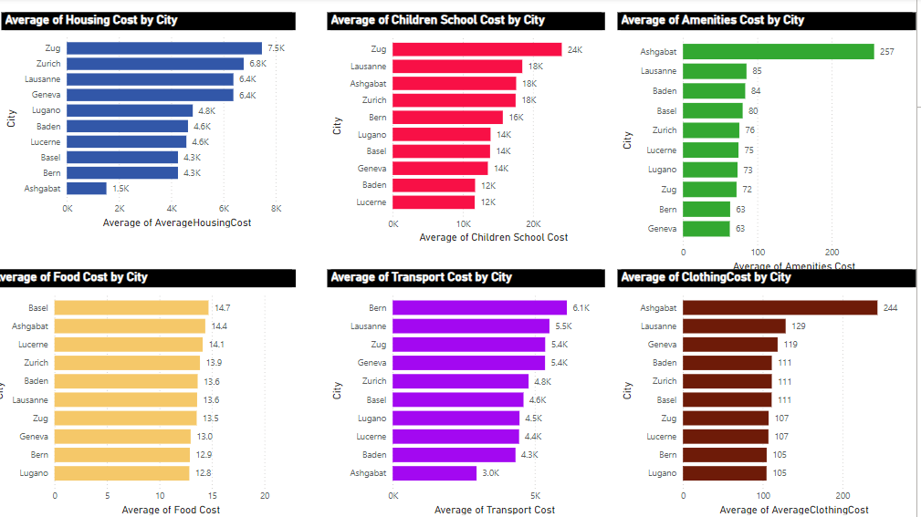
F. 10 cities consistently had the highest cost of living across all the components of cost of living with ASHGABAT having a very high margin in Amenities and clothing
.

Slide 20
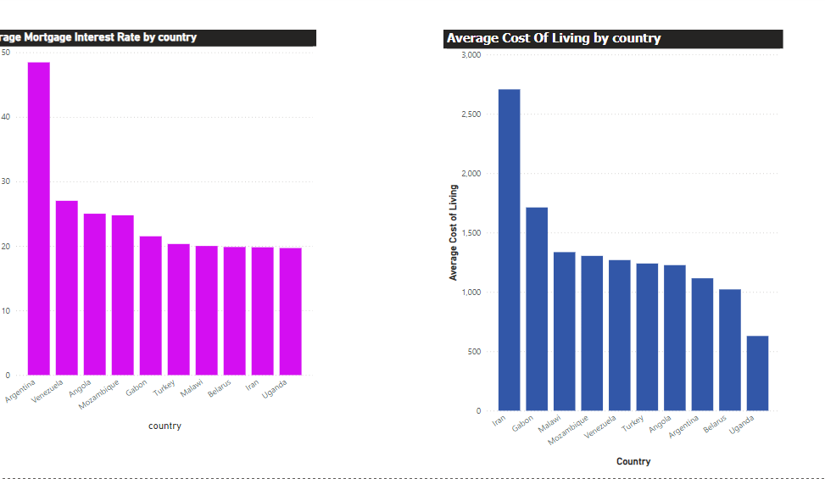

G. I was also able to ascertain that mortgage interest rate and cost of living have a positive linear correlation. All the top 10 cities with high mortgage interest rates were also the top 10 expensive cities to live in

Slide 21



www.linkedin.com/in/uju-nzurumike
nzurumikeuju2@gmail.com

